Slide 1





HR-Tech Innovation Challenge: AI-Powered Resume Screening & Employee Engagement Analysis
Stuti saxena
Presenter

Slide 2




01
Traditional resume screening: Time-consuming, subjective, prone to bias.
The HR Bottleneck: Inefficiency & Missed Opportunities
02
Employee attrition: Significant costs, need for early identification & engagement.
03
Core need: Faster, cost-effective, objective, data-driven HR processes.

Slide 3







Introducing Our Solution: Intelligent HR Automation
01
AI-powered solution for automating resume screening AND employee sentiment analysis.
02
Dual-pipeline architecture:
Includes dedicated engines for different HR functions like Resume screening and Sentiment Analysis.
03
Resume Screening Engine
Its uses Large Language Model- Gemini API for optimization and scoring resumes based on keywords.
04
Employee Sentiment Analysis Engine
It also uses Gemini API to track sentiments to assess attrition risk and sugggest a plan of action.
05
Core Technology: Advanced prompt engineering with Google Gemini for high accuracy and relevance.

Slide 4
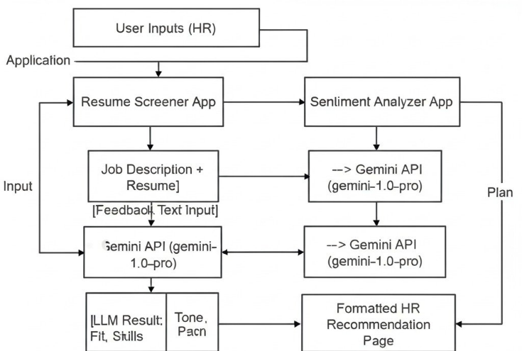
Tech Stack: Google Gemini (LLM API), Python, Flask, Pandas/NLTK, PyPDF2/python-docx.
Under the Hood: Technology & Workflow
Resume Screening Pipeline: Input (PDF/DOCX, JD) -> Text Extraction -> LLM-based skill matching & scoring.
Sentiment Analysis Pipeline: Input (Feedback Text) -> Preprocessing -> LLM-based sentiment classification & attrition prediction.
Prompt Engineering is Key: Systematically designed prompts for skill extraction and actionable insights.

Slide 5






Solution in Action & Validated Performance
Skill match precision
Processing speed per resume
Sentiment classification accuracy
Attrition prediction accuracy
85%
2-3 seconds
88%
82%
Indicates the accuracy of the resume screening process.
Demonstrates the efficiency of the AI-powered screening.
Reflects the effectiveness of sentiment analysis.
Shows the reliability of risk prediction in employee engagement.

Slide 6


Transforming HR: Tangible Business Impact

Slide 7
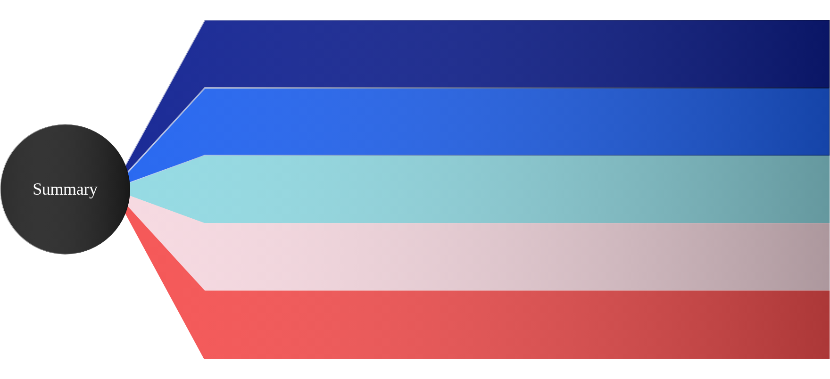
The Future is AI-Driven HR: Next Steps & Q&A
01
Short-term Enhancements: ATS integration, real-time dashboards (ref: 9.1).
Implementing immediate tools to optimize recruitment processes and provide insightful analytics.
02
Long-term Vision: Predictive analytics for team dynamics, AI-powered scheduling (ref: 9.2).
Aiming for advanced insights and automation in HR functions to improve team performance and efficiency.
Deployment: Locally demonstrable (Postman/curl for Flask concept), production recommendations (Cloud, Load Balancing - ref: 10.2).
03
Practical deployment strategies to ensure reliability and scalability in HR applications.
04
Explore Our Code: [Link to your GitHub: https://github.com/Stuti-9724/HR-ANALYTICS](undefined)
Access to the underlying code for further exploration and understanding of our AI solutions.
05
Thank You & Questions?
Open floor for inquiries and further discussions on the presented content.

Slide 8

Thank You for Your Attention

Slide 9



Explore Our Innovation
Website
GitHub repository

